Slide 1
Computer Vision Metrics

Slide 2
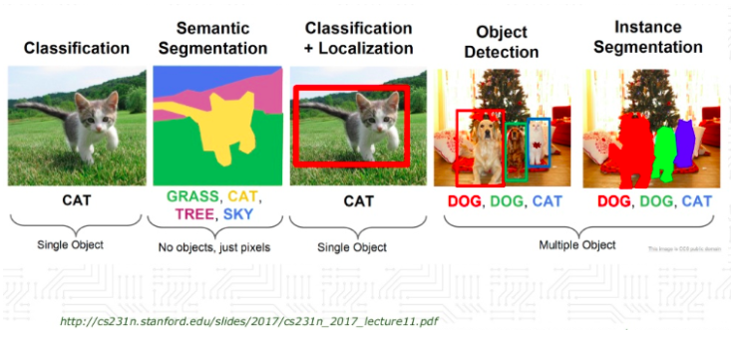

Slide 3
Metrics for Image Classification

Slide 4
Confusion Matrix (binary classification)
Number of inputs classified as 0 and that have a true class of 0
(TRUE POSITIVES, TP)
Number of inputs classified as 1 and that have a true class of 0
(FALSE NEGATIVES, FN)
In the case of the perfect classifier:
FN = 0 and FP = 0
True Label 0
Number of inputs classified as 0 and that have a true class of 1
(FALSE POSITIVES, FP)
Number of inputs classified as 1 and that have a true class of 1
(TRUE NEGATIVES, TN)
True Label 1
Predicted Label 0
Predicted Label 1

Slide 5
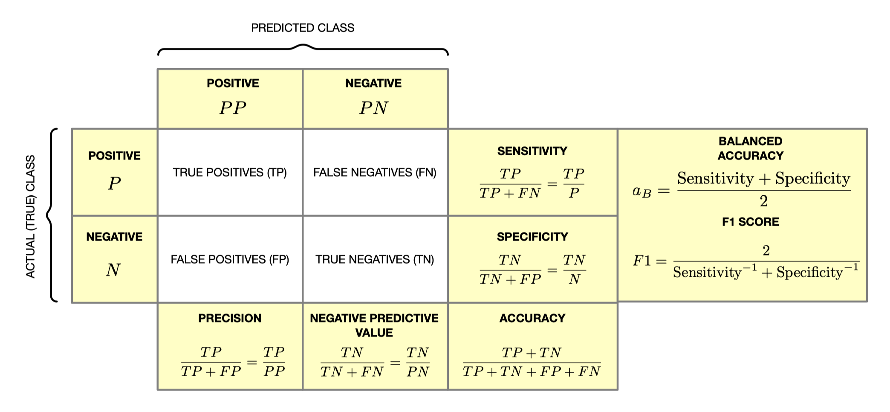
Summary – confusion matrix

Slide 6
Note
All the previous metrics can be used in any segmentation task. You treat each pixel as correctly classified or wrongly classified So you are dealing with a binary classification problem
But you must be careful when the portion of the image to be segmented is very small. You will easily get high accuracy but the segmentation could be very poor.

Slide 7
Confusion Matrix (Multi-class classification)
Number of inputs classified as 0 and that have a true class of 0
Number of inputs classified as 1 and that have a true class of 0
Number of inputs classified as 2 and that have a true class of 0
…
True Label 0
Number of inputs classified as 0 and that have a true class of 1
Number of inputs classified as 1 and that have a true class of 1
True Label 1
…
…
…
…
…
Predicted Label 0
Predicted Label 1
Predicted Label 2

Slide 8
Metrics for Image Localisation

Slide 9
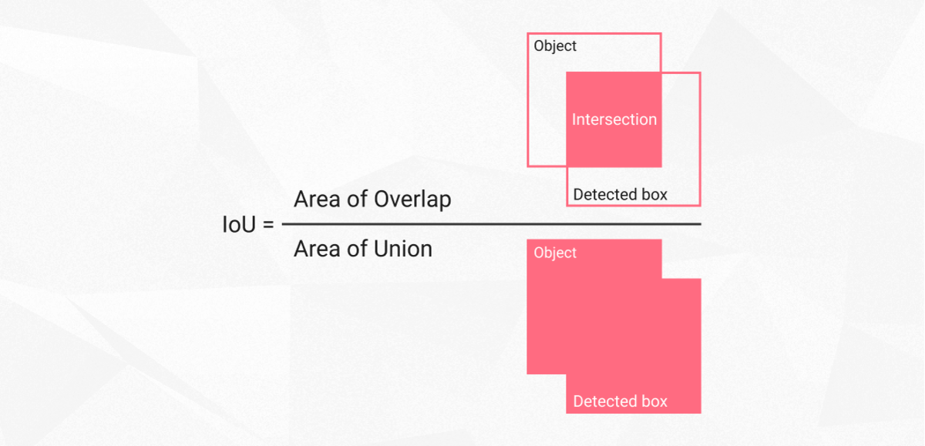
Intersection Over Union (IoU)
Intersection over union is actually a very straightforward and self-explanatory measurement and is based on the Jaccard index (a coefficient for similarity for two sets of data)
https://www.superannotate.com/blog/intersection-over-union-for-object-detection

Slide 10
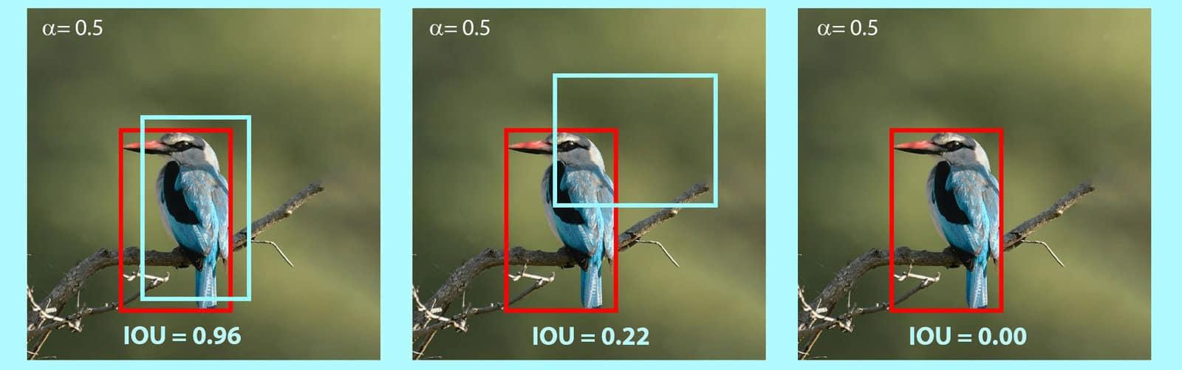
IoU - An example
https://learnopencv.com/intersection-over-union-iou-in-object-detection-and-segmentation/

Slide 11
IoU in image segmentation

Slide 12
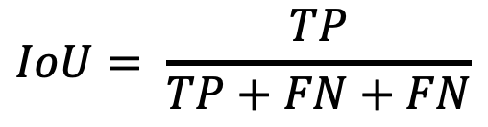
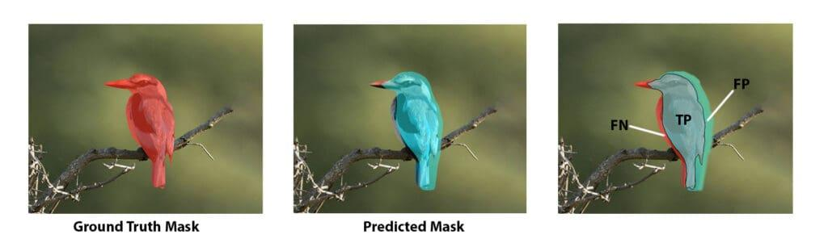
Intersection Over Union (IoU)
https://www.superannotate.com/blog/intersection-over-union-for-object-detection

Slide 13
Image Similarity Metrics

Slide 14
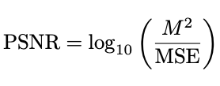
MSE and PSNR
Peak Signal-to-Noise Ratio (PSNR) is an engineering metric used to measure the quality of a reconstructed image (e.g., after compression or AI generation) compared to the original.
M: The maximum possible pixel value (usually 255 for 8-bit images)
MSE: The average squared difference between the original and reconstructed pixels.
A higher PSNR value indicates better quality (less noise).

Slide 15
MSE and PSNR
Limitations
Not Perceptual: PSNR looks at raw pixel math, not how humans see.
The Blur Problem: An image can have a high PSNR but look slightly blurry, or a lower PSNR but look sharper to the human eye.
Alternative: SSIM (Structural Similarity Index) is often used alongside PSNR to capture perceptual quality.

Slide 16
Mean Structural Similarity Index
The Structural Similarity Index Measure (SSIM) is a perceptual metric that quantifies image quality degradation caused by processing (compression, noise, etc.).
The Philosophy: Unlike MSE/PSNR (which just check if pixel numbers match), SSIM attempts to mimic the Human Visual System (HVS).
Key Insight: Humans are highly sensitive to changes in structure (edges, shapes, textures), not just absolute pixel intensity.

Slide 17
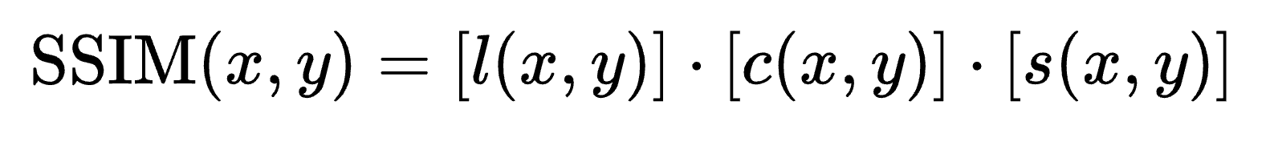





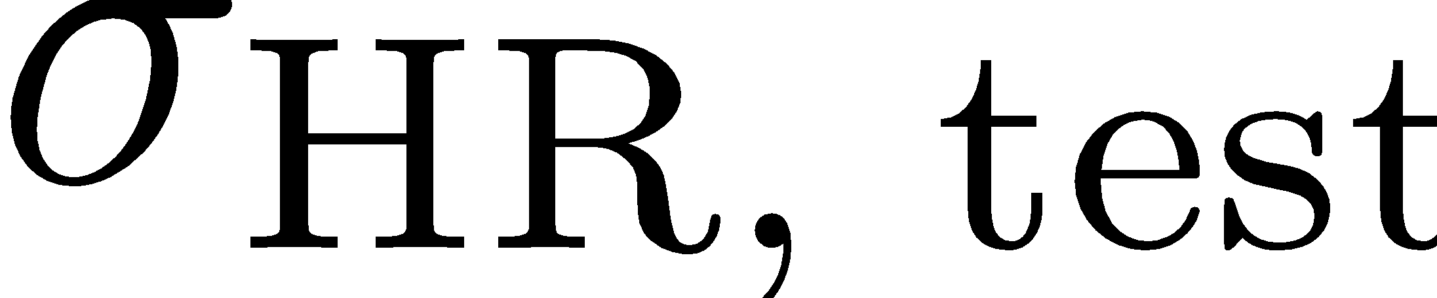
Mean Structural Similarity Index
SSIM compares two windows (patches) of an image based on three independent features:
Luminance (l): Compares the brightness (average pixel intensity).
Contrast (c): Compares the range of pixel values (standard deviation).
Structure (s): Compares the local patterns/textures (correlation) after removing brightness and contrast.
Luminance
Contrast
Structure
: Mean
: Standard Deviation
: covariance

Slide 18
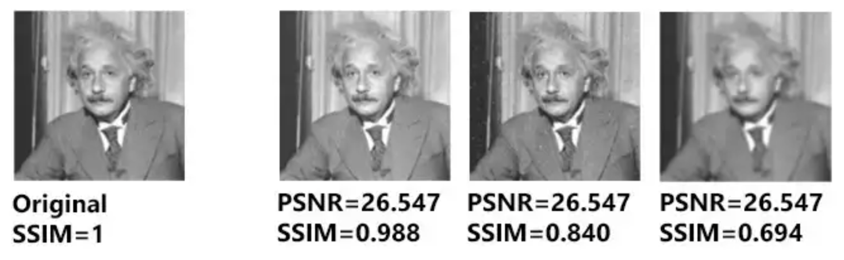
Mean Structural Similarity Index
Interpreting the Score
Range: 0 to 1.
1.0: Perfect match (The images are identical).
0.95 - 0.99: High quality (Very hard to tell the difference).
< 0.8: Noticeable distortion or loss of detail.

